Slide 1

Rockbuster Stealth
2020 Company Strategy Planning

Slide 2
Overview
Rockbuster Stealth LLC is a global movie rental company that wants to enter the online video rental service to stay competitive with competitors like Netflix and Amazon Prime.
The company has its store presence in Australia and Canada with a revenue of $31,060 and $30,252 respectively.
The company has a customer base of 599 customers in 109 countries.

Slide 3
Most popular and least popular movies
Top revenue generating movies
title | rating | genre | total_amount_paid
Telegraph Voyage | PG | Music | 215.75
Zorro Ark | NC-17 | Comedy | 199.72
Wife Turn | NC-17 | Documentary | 198.73
Innocent Usual | PG-13 | Foreign | 191.74
Hustler Party | NC-17 | Comedy | 190.78
Saturday Lambs | G | Sports | 190.74
Titans Jerk | PG | Sci-Fi | 186.73
Harry Idaho | PG-13 | Drama | 177.73
Torque Bound | G | Drama | 169.76
Dogma Family | G | Animation | 168.72
There are total of 1000 movies in the English language.
The most popular movies are Juggler Hardly, Shock Cabin and Scalawag Duck that are rented the most.
Telegraph Voyage and Oklahoma Jumanji are the highest and the least revenue generating movie, respectively.
Least revenue generating movies
title | rating | genre | total_amount_paid
Oklahoma Jumanji | PG | New | 5.94
Duffel Apocalypse | G | Documentary | 5.94
Texas Watch | NC-17 | Horror | 5.94
Freedom Cleopatra | PG-13 | Comedy | 5.95
Young Language | G | Documentary | 6.93
Rebel Airport | G | Music | 6.93
Cruelty Unforgiven | G | Classics | 6.94
Treatment Jekyll | PG | Drama | 6.94
Lights Deer | R | Classics | 7.93
Japanese Run | G | Horror | 7.94
*total_amount_paid in dollars

Slide 4
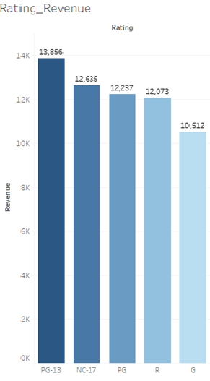
Renting pattern
Rental duration
Maximum | 7 days
Minimum | 3 days
Average | 5 days
PG-13 is the top revenue generating in movie rating category.
Other ratings contribute almost equally to the revenue generation.
All genres have average rental duration of 5 days except for thriller genre with 6 days of average rental duration.
Rental rate, Rating does not have much impact on renting pattern.
Rental rate | Count of rental rate
0.99 | 5144
4.99 | 4782
2.99 | 4670

Slide 5
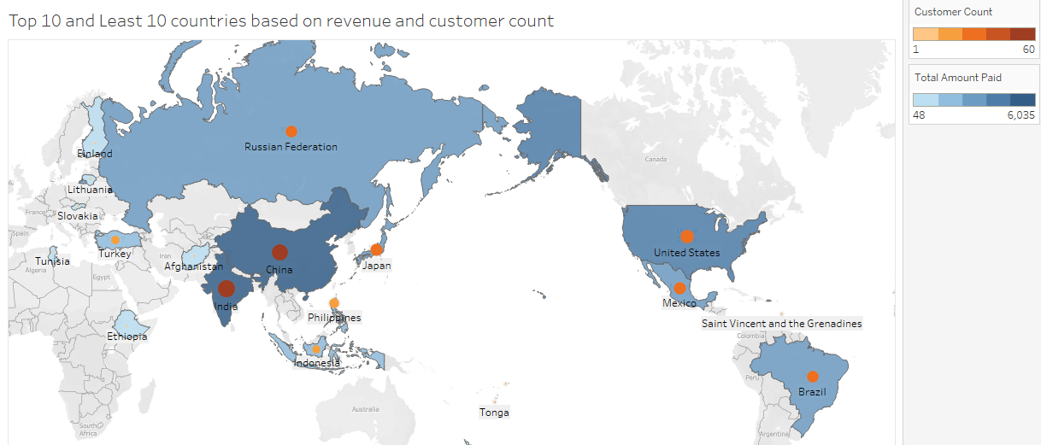
Countries with high and low revenue
Top 10 countries contribute 52% of the company’s revenue.
India and China being the top players with high customer count.
American Samoa, Lithuania being the least revenue generating countries.

Slide 6
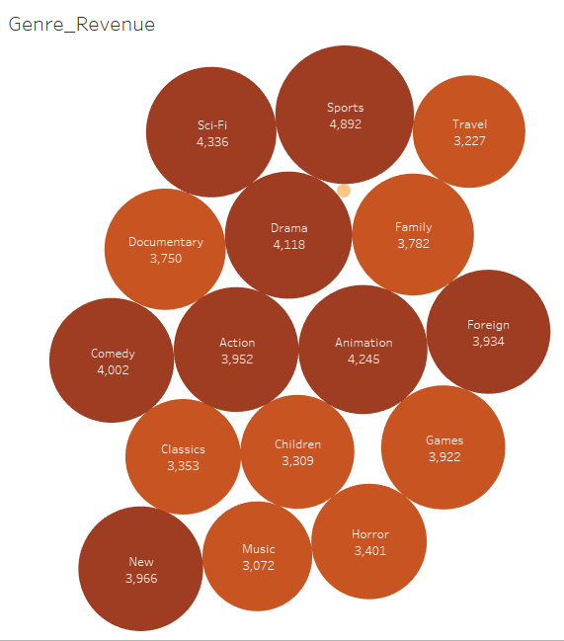
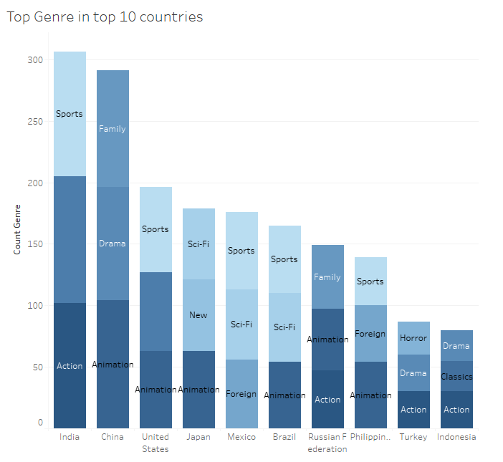
Genre
Sports, Sci-Fi and Animation are the top revenue generating genres.
Thriller genre is the least revenue generating genre. And was rented only for 11 times.
Action, Documentary, Sports are the popular genre in India the high revenue generating country.
Animation, Drama and Family are popular in China.

Slide 7
Top customers
id | first_name | last_name | city | country | revenue
148 | Eleanor | Hunt | Saint-Denis | Runion | 211.55
526 | Karl | Seal | Cape Coral | United States | 208.58
178 | Marion | Snyder | Santa Brbara dOeste | Brazil | 194.61
137 | Rhonda | Kennedy | Apeldoorn | Netherlands | 191.62
144 | Clara | Shaw | Molodetno | Belarus | 189.6
459 | Tommy | Collazo | Qomsheh | Iran | 183.63
181 | Ana | Bradley | Memphis | United States | 167.67
410 | Curtis | Irby | Richmond Hill | Canada | 167.62
236 | Marcia | Dean | Tanza | Philippines | 166.61
403 | Mike | Way | Valparai | India | 162.67
Top revenue generating customers from all countries.
id | first_name | last_name | city | country | revenue
84 | Sara | Perry | Atlixco | Mexico | 128.7
518 | Gabriel | Harder | Sivas | Turkey | 108.75
587 | Sergio | Stanfield | Celaya | Mexico | 102.76
537 | Clinton | Buford | Aurora | United States | 98.76
367 | Adam | Gooch | Adoni | India | 97.8
Top revenue generating customers from top 10 countries.

Slide 8
Conclusions
India, China, United States, Japan and Mexico are top 5 revenue generating countries.
52% of the revenue is from the top 10 countries.
Rockbuster has 14,596 rentals with 599 customers in 109 countries.
Most popular genres were Sports, Sci fi and animation.
Thriller genre has been rented out the least compared to all other genres.

Slide 9
Recommendation
Top countries could be prioritized to introduce the online movie rental.
Customer could be retained by rewarding the high valued customers. Reference program could be introduced to increase the customer base.
Customer survey could be conducted with the existing customers to understand the renting pattern more in detail. All language movies should be added to the inventory. Regional language movies could increase the customer base.
Marketing strategies like sending email to the active customers as and when new movies get added.

Slide 10
Link to Tableau:
https://public.tableau.com/app/profile/vijayalakshmi.venugopal/viz/Rockbuster_Analysis/Countries_Revenue
Thank you

